Slide 1
Project Management
Managing Risk

Slide 2
Risk
Dictionary definition: “The possibility of loss or injury”
Question: So if there is a possibility of loss or injury, then why even perform a certain task?
The change that an undesirable event will occur and the consequences of all its possible outcomes

Slide 3
Payoff!!
Utility
Utility
Potential payoff
Potential payoff
Risk Averse
Risk Seeking
Utility
Potential payoff
Risk Neutral

Slide 4
Risk Management
The identification of as many risks as possible
Minimizing their impact
The managing of responses to those events that do materialize
Providing contingency funds to cover risks that do materialize.

Slide 5
Components of Risk Management
Identifying the sources of risk
Analyzing and assessing risk
Responding to risk
Contingency Planning
Establishing contingency reserves

Slide 6
Identify risks in the project
Process of transforming uncertainties and issues about a project into distinct risks that may be described and measured.

Slide 7
Risk Identification
Risks cannot be assessed until identified
  Need methodical process
  Risk definition: Scenarios & Consequences
    Central question -- what can go wrong with this project, activity, task?
Good risk event definition
  Clear and concise – easily understood
  Risk event captured

Slide 8
Evaluation of risks in the project
Process of classifying & prioritizing identified risks with respect to potential severity of project consequences (Scope, Time, Performance, Costs).

Slide 9
Evaluation of Risks – The Risk Severity Matrix (RSM)
The RSM is a Systematic determination of the consequences of identified risk events – Analysis in 3 phases
  PHASE 1: Determination of likelihood of occurrence --Low, Medium, or High
  PHASE 2: Determination of Impact of Event
    Low, Medium, or High ON...
    Cost, Performance, Scope, Time (Basics)
  PHASE 3: Determine the Severity of risk event
    Low, Medium, or High

Slide 10
Constructing the Risk Severity Matrix
Impact
Low
Medium
High
Medium
High
High
High
Likelihood
(probability)
Medium
Low
High
High
Low
Medium
Medium
Low

Slide 11
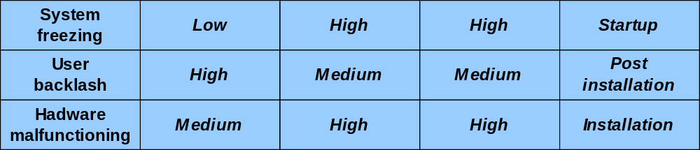
Risk Assessment Matrix
Figure 5-2
Detection
difficulty-
LMH
Chance-
LMH
Severity-
LMH
Risk event
When

Slide 12
Planning for risks in the project
Planning is function of deciding what, if anything, should be done with a specific risk event – The STRATEGY for managing the risk event.

Slide 13
The Risk Management Plan
Risk Management Plan
  Describes the process to be followed during project
  Continuously updated – WBS, Budget
Identifies
  Responsibilities
  Process details
  Methodology
Part of the Project Management Plan

Slide 14
How does one respond to a risk?
Reduce the Risk
  Common plan that is used.
Retain the Risk
  The project owner assumes the risk because the chance of such an event happening is slim (e.g. flood or earthquake)

Slide 15
How does one respond to a risk?
Transferring the Risk
  The risk is passed on to another party (e.g. the whole development project is given to a contractor - fixed price contracts)
Share the risk
  Partnering with another company

Slide 16
Contingency Planning
An alternative plan that will be used if a possible forseen risk event becomes a reality
It is necessary to identify the “triggers” that will activate the implementation of the contingency plan

Slide 17
Example
In an afternoon wedding reception that is held outdoors:
  Risk Event : It might rain during the reception
  Contingency Plan : Set up tents
  Trigger : Overcast clouds in the morning

Slide 18
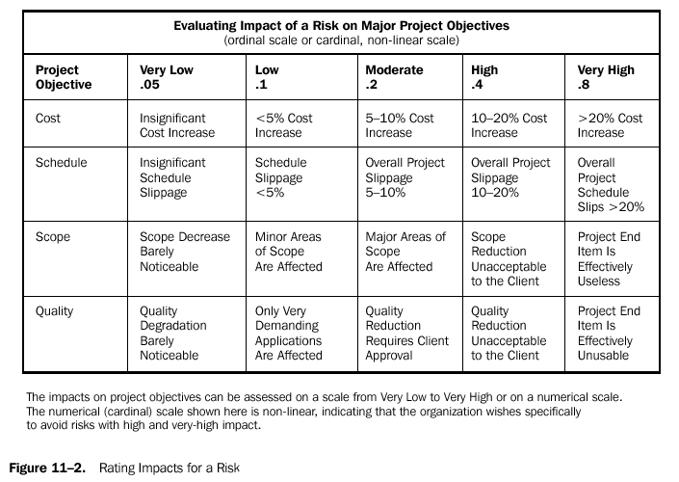
PMBOK Ratings Impact for a Risk

